Slide 1




Neural Network Basics
João Campagnolo
Computational Neuroscience class
Spring 2024

Slide 2
Let’s start with the example from 3b1b

Slide 3
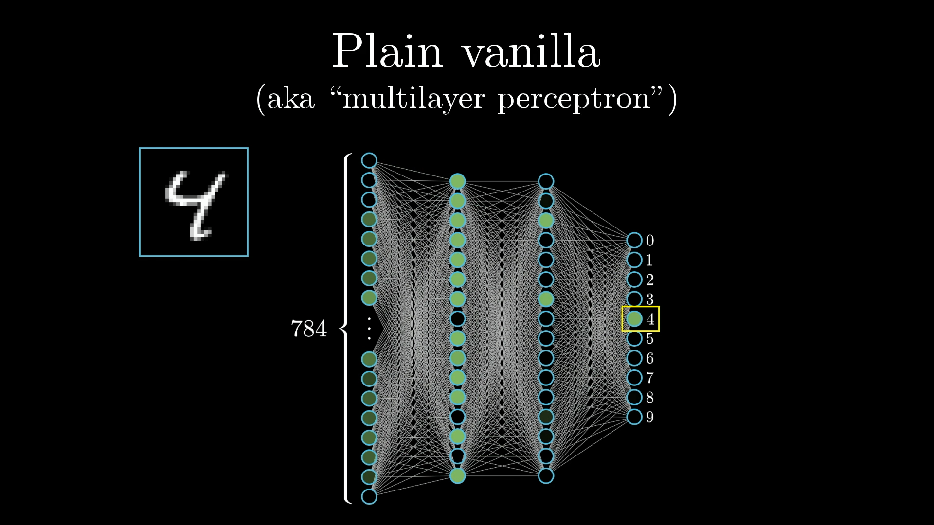

Slide 4
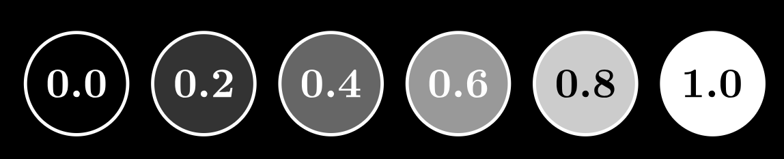
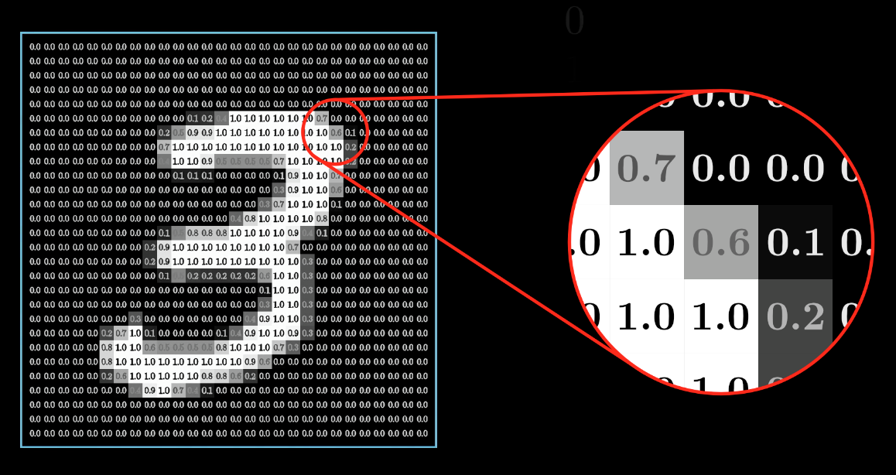
Every neuron has an activation between 0.0 and 1.0, sort of analogous to how neurons in the brain can be active or inactive.
Each pixel in the original image has a value between 0.0 (black) and 1.0 (white).

Slide 5
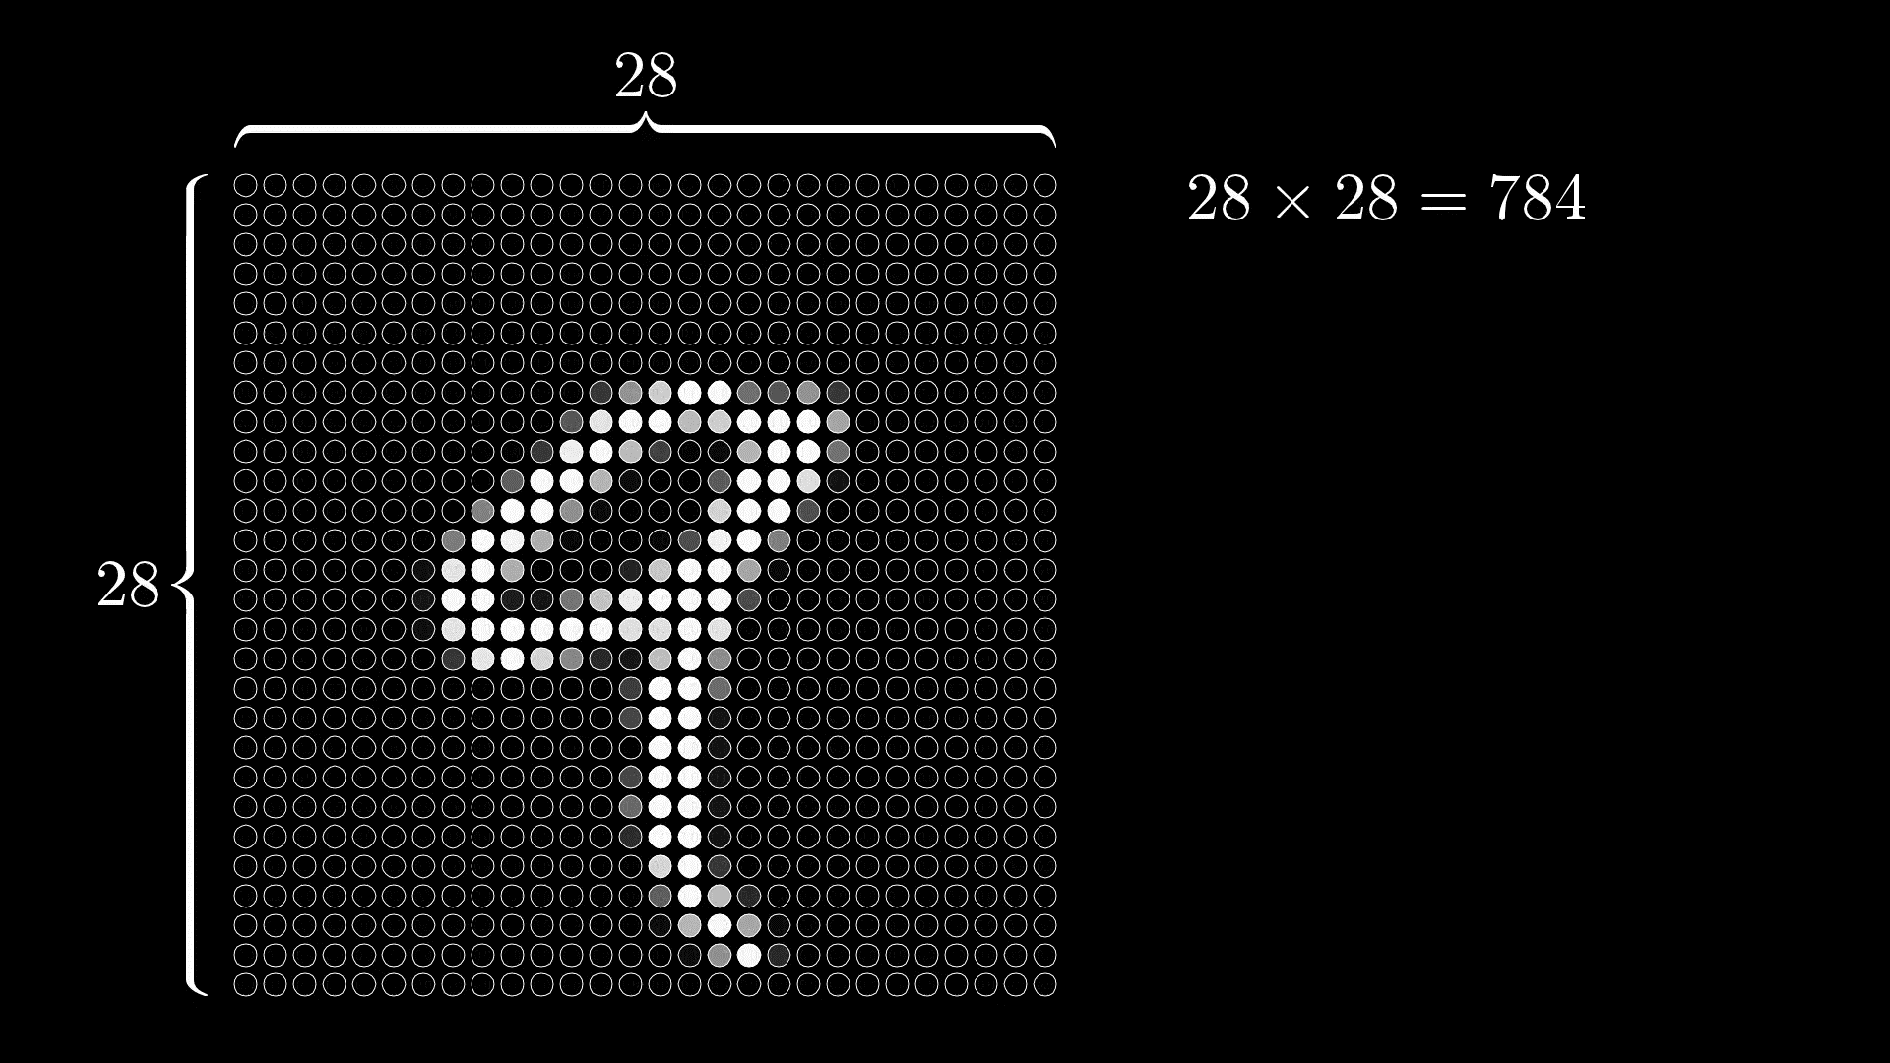

Slide 6
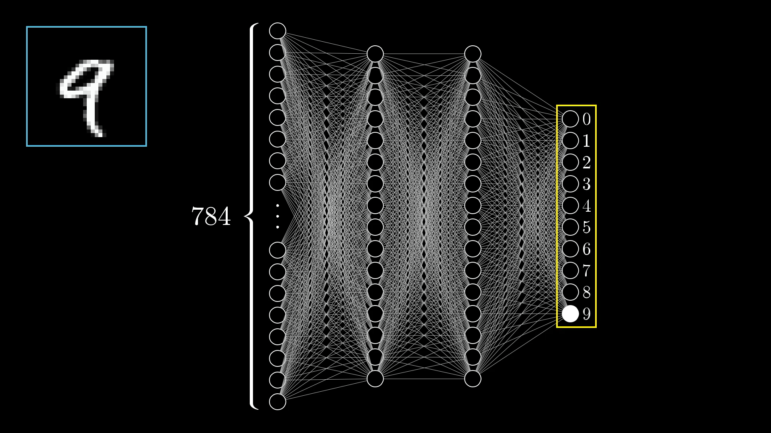
Set input and output dimensions

Slide 7
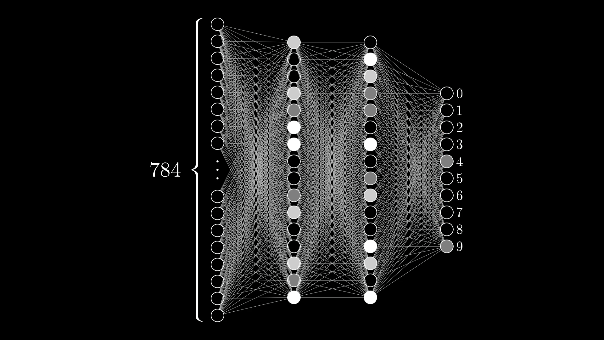
What is the output the network will choose?

Slide 8
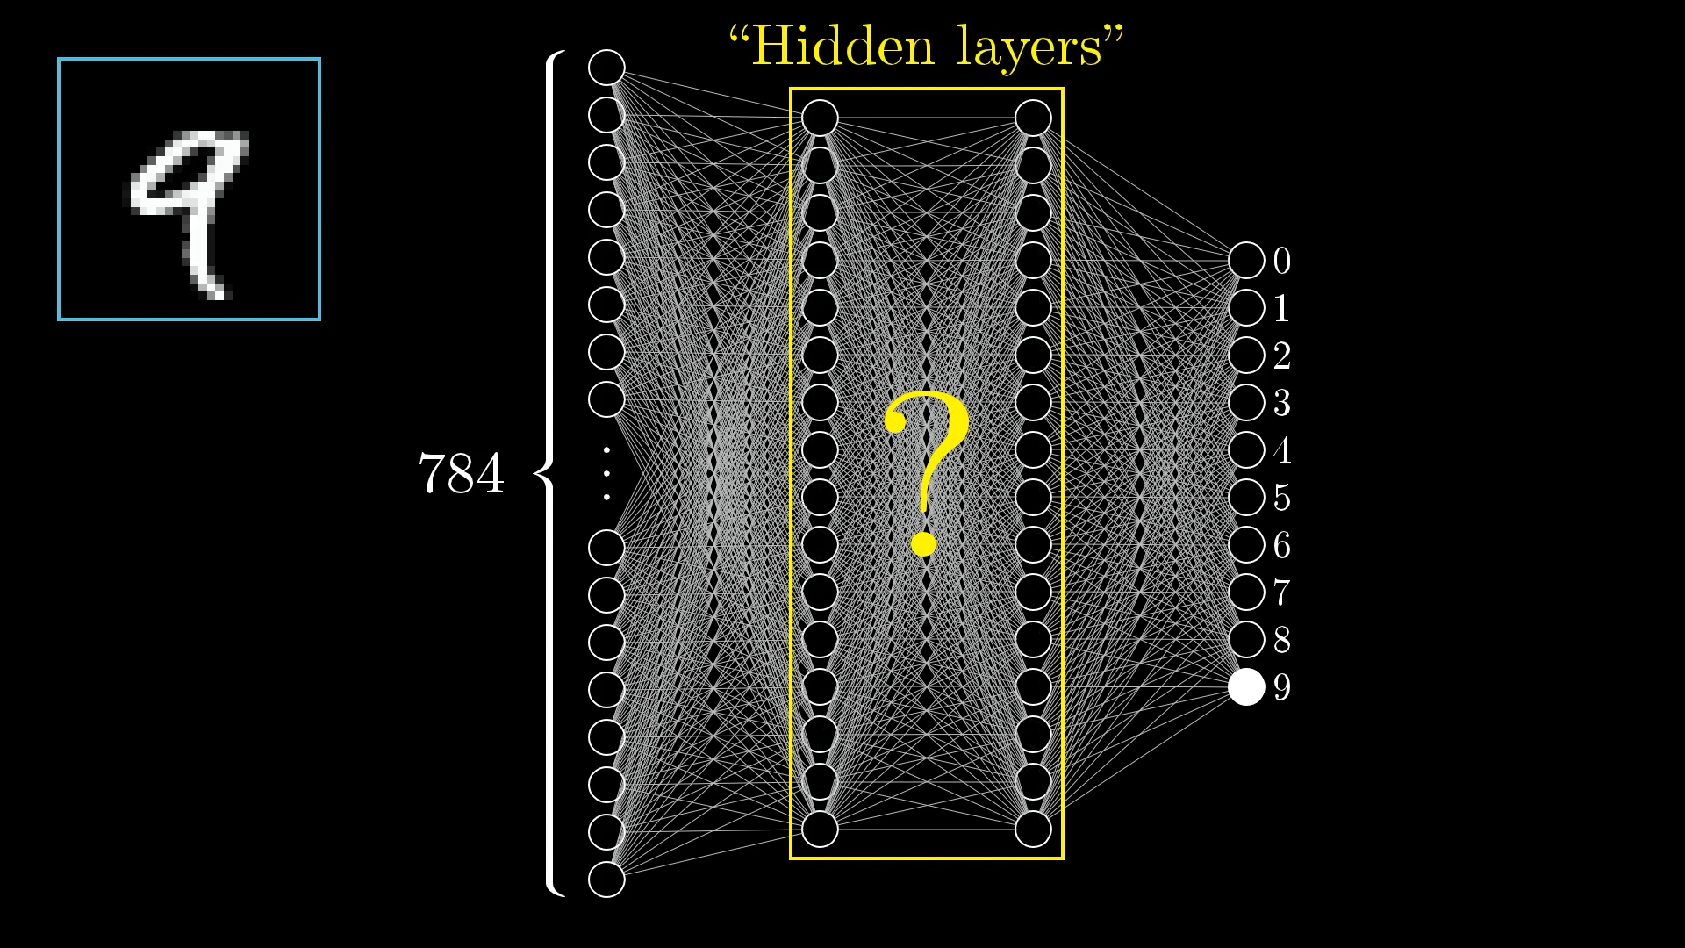
(kind of an arbitrary choice)

Slide 9
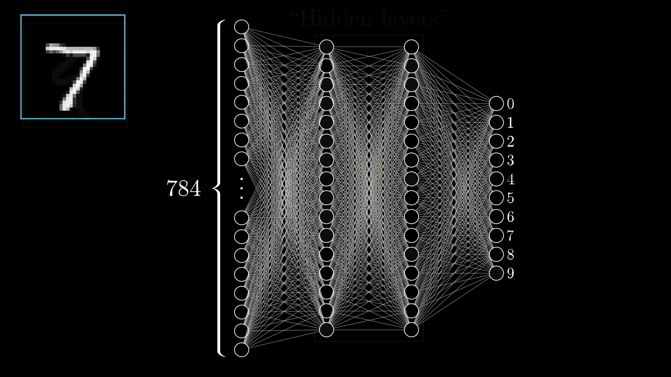
not all these connections are equal

Slide 10
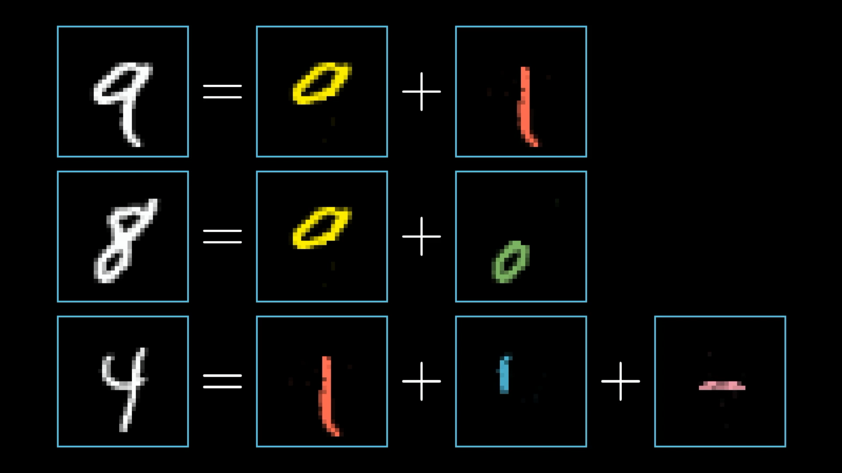
What’s the best hope for what those middle layers are doing?

Slide 11
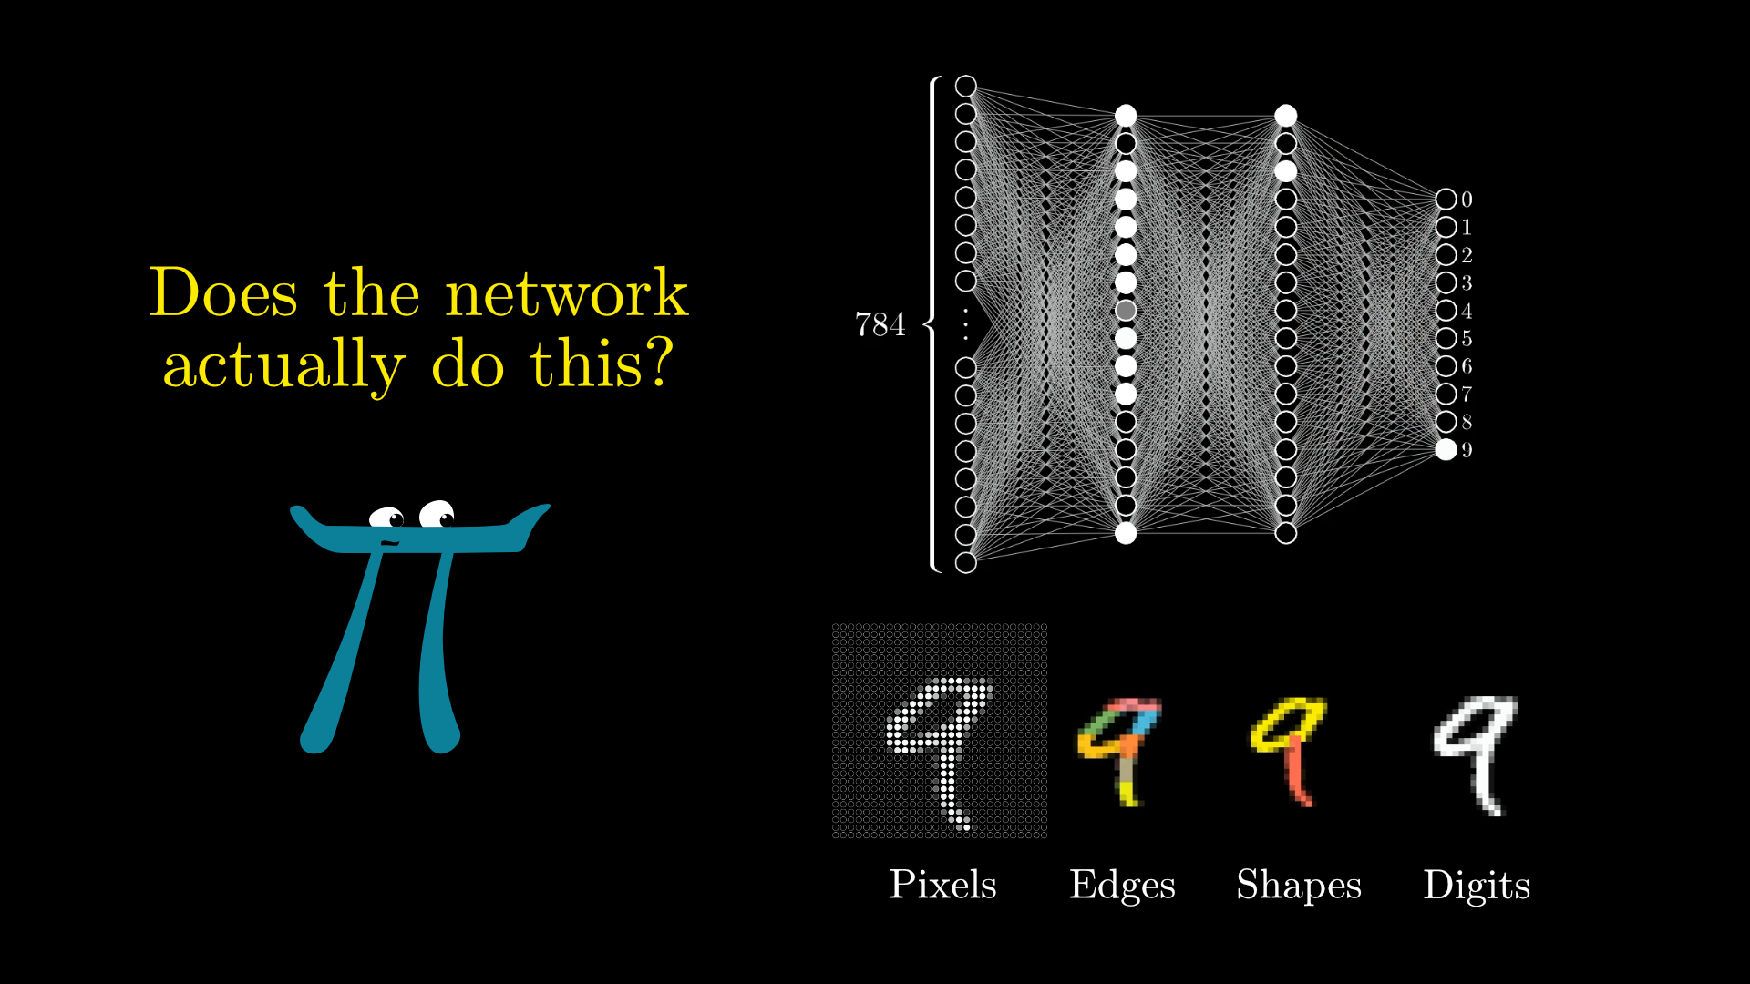
Could each neuron in the second layer of the network corresponds to some little edge?

Slide 12
“The layered structure of the neural network is great because it allows you to break down difficult problems into bite-size steps, so that moving from one layer to the next is relatively straightforward.”

Slide 13
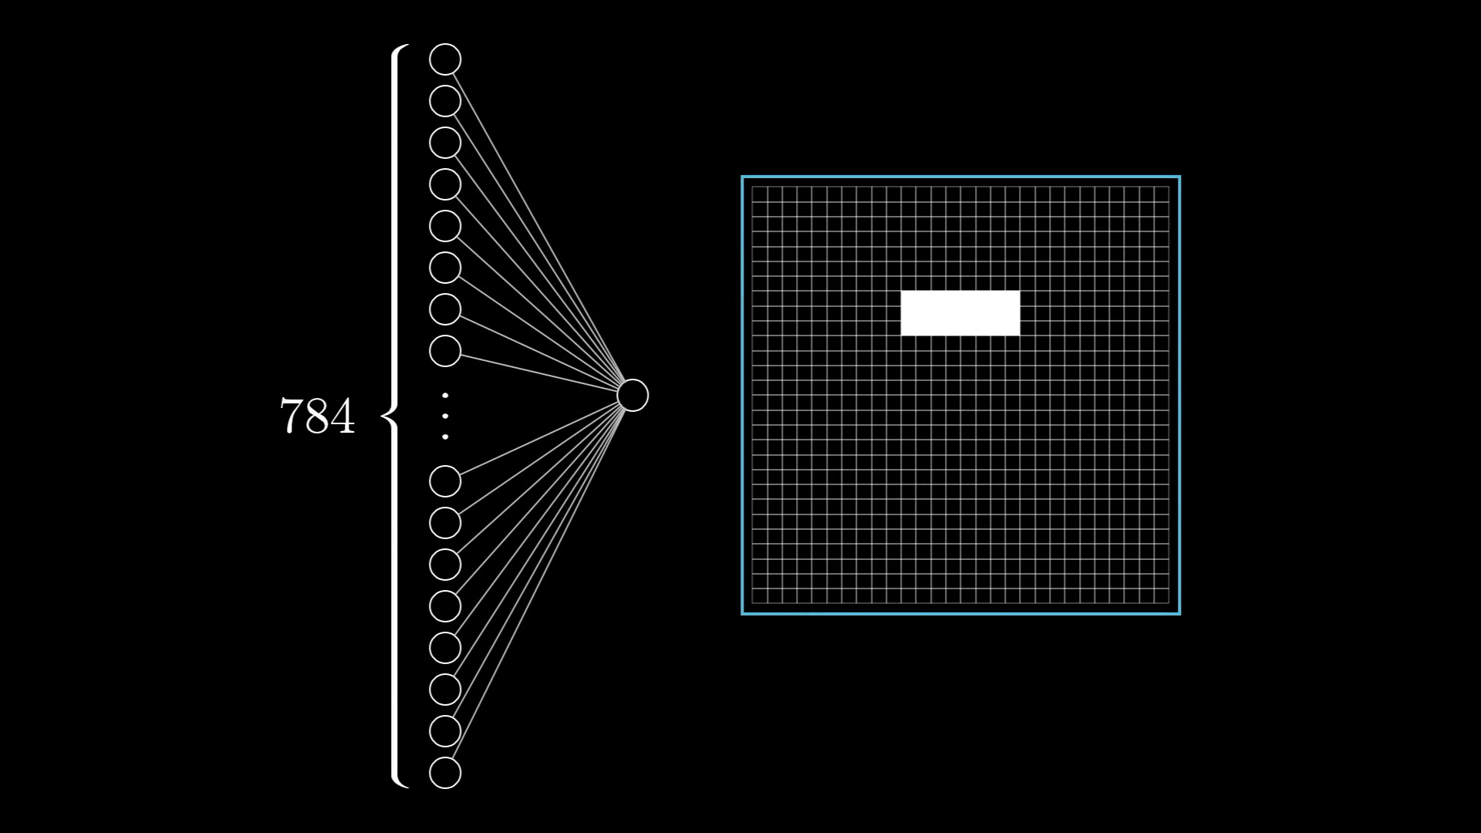
How Information Passes Between Layers
We want this one, specific neuron in the second layer to pick up on whether the image contains this one, specific edge.

Slide 14
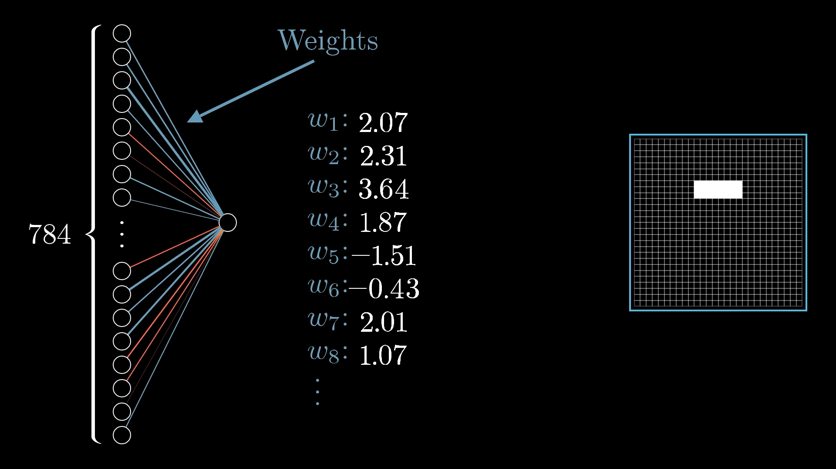
Each weight is an indication of how its neuron in the first layer is correlated with this new neuron in the second layer.

Slide 15
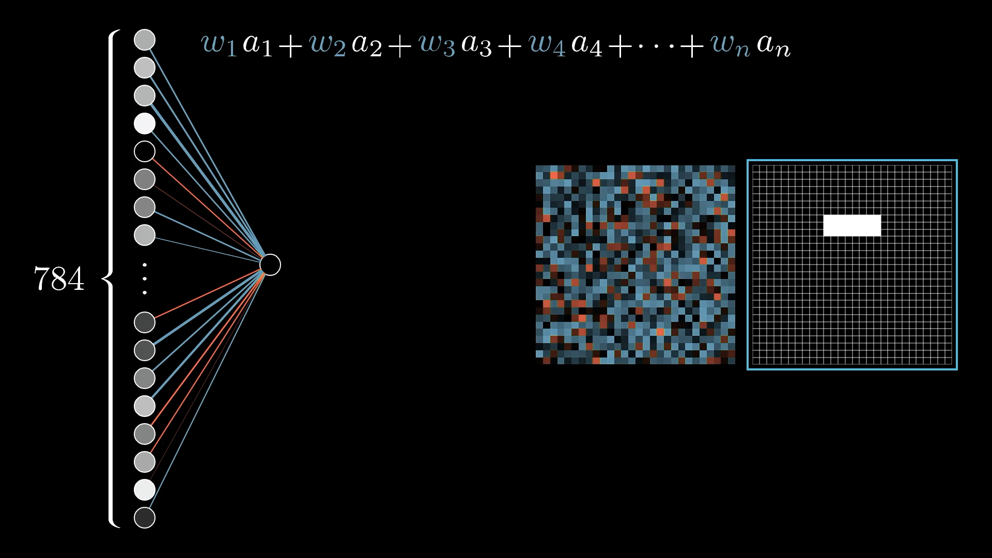
Arranging the weights into this 28x28 grid:

Slide 16
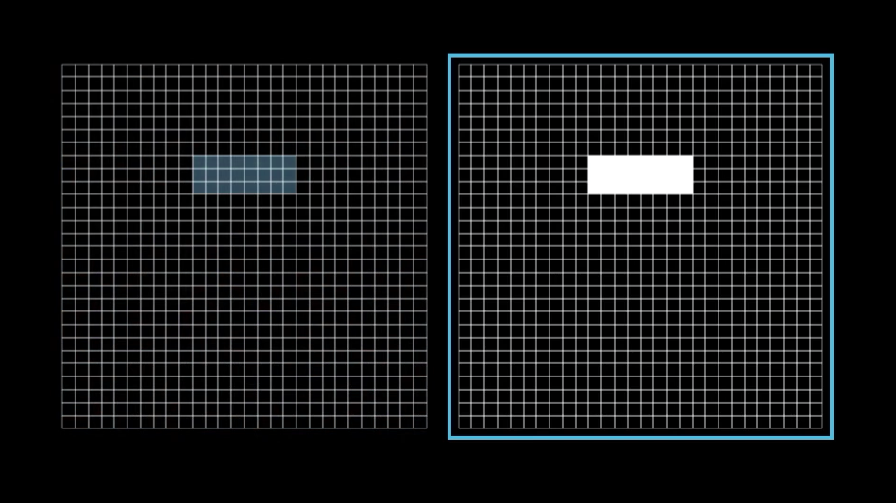
With these weights, the neuron in the second layer will be more activated when pixels in this region are more activated.

Slide 17
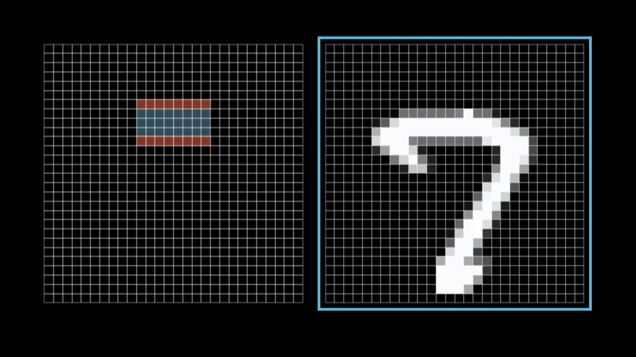
To really pick up on whether or not this is an edge, you might want to have some negative weights associated with the surrounding pixels.

Slide 18
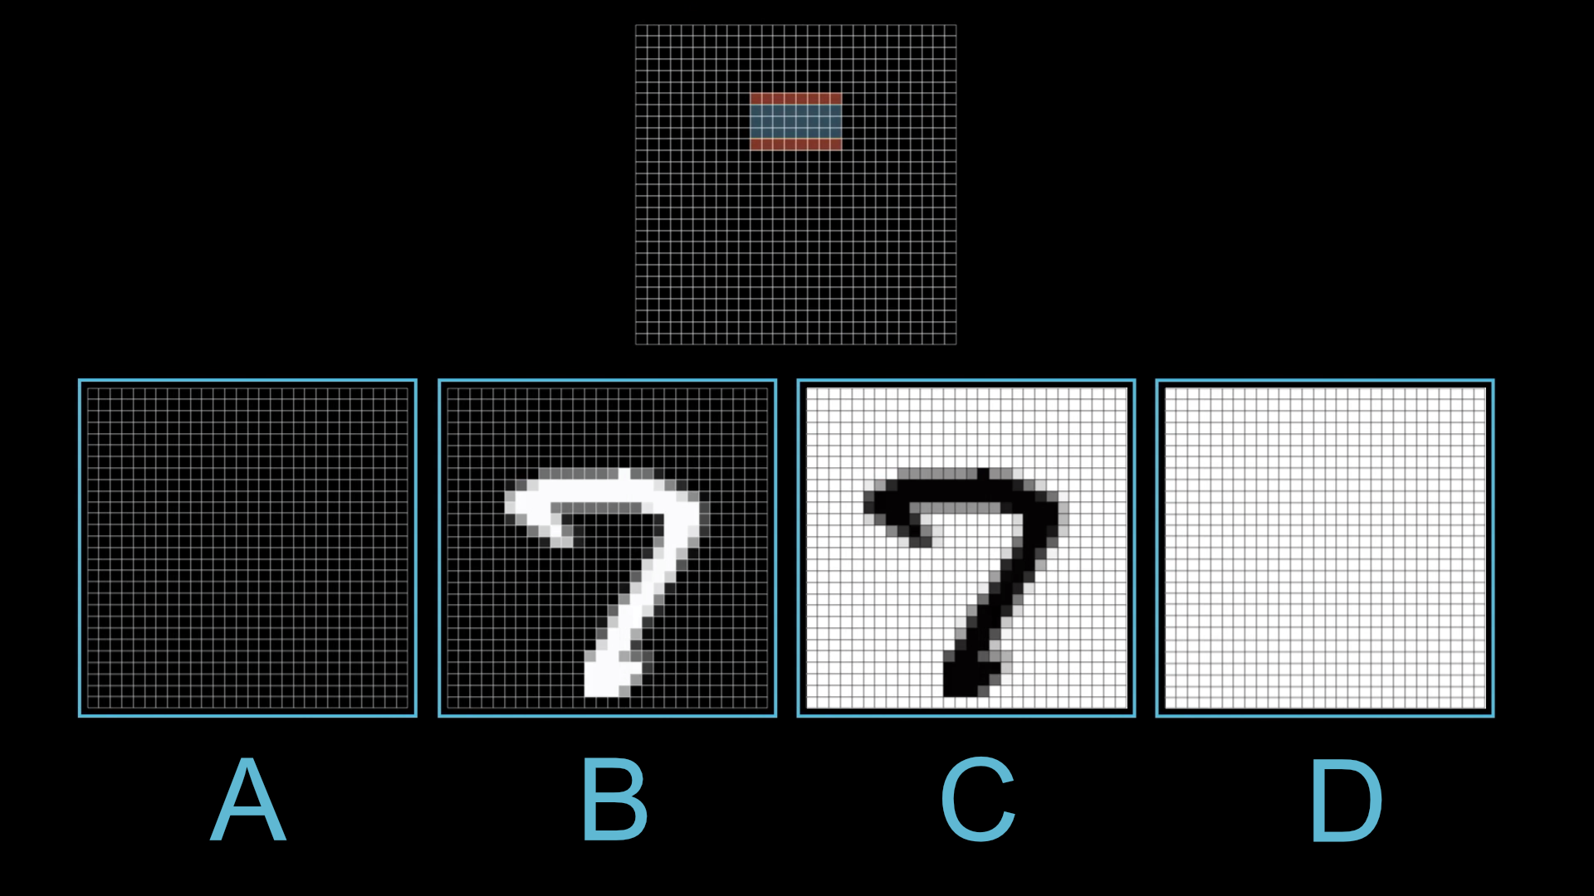

Slide 19
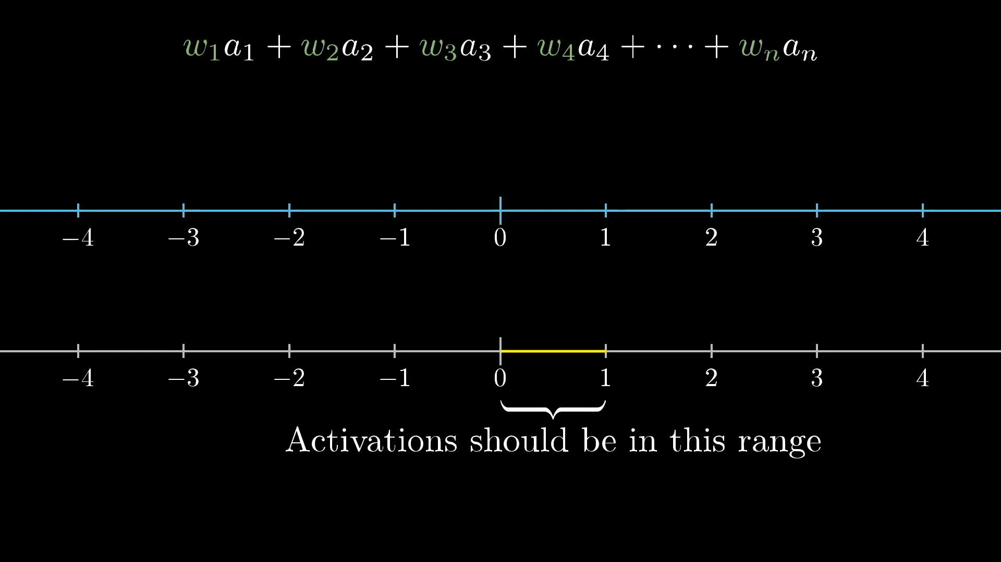

Slide 20
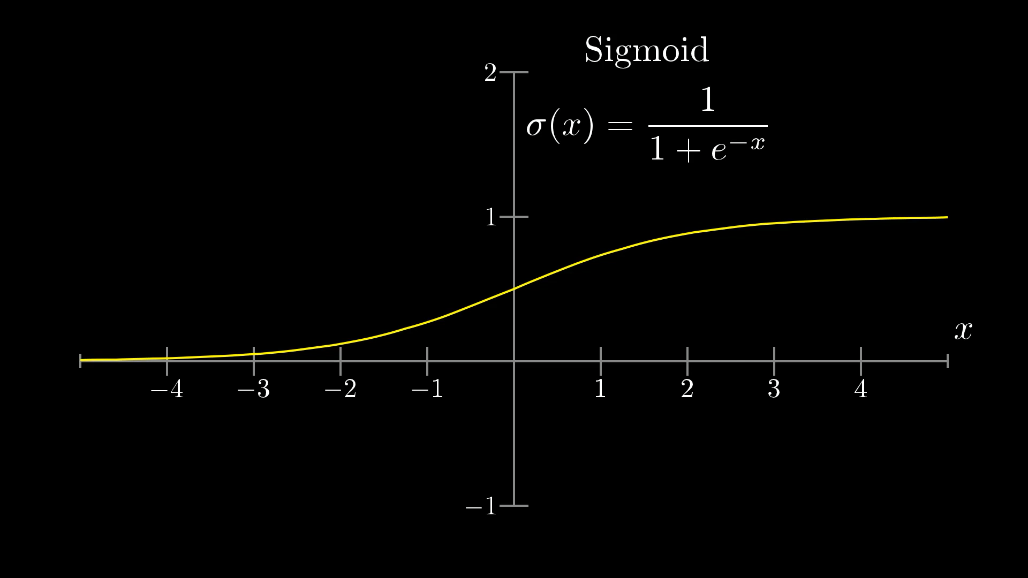
The sigmoid function is just the squishing function we need!

Slide 21
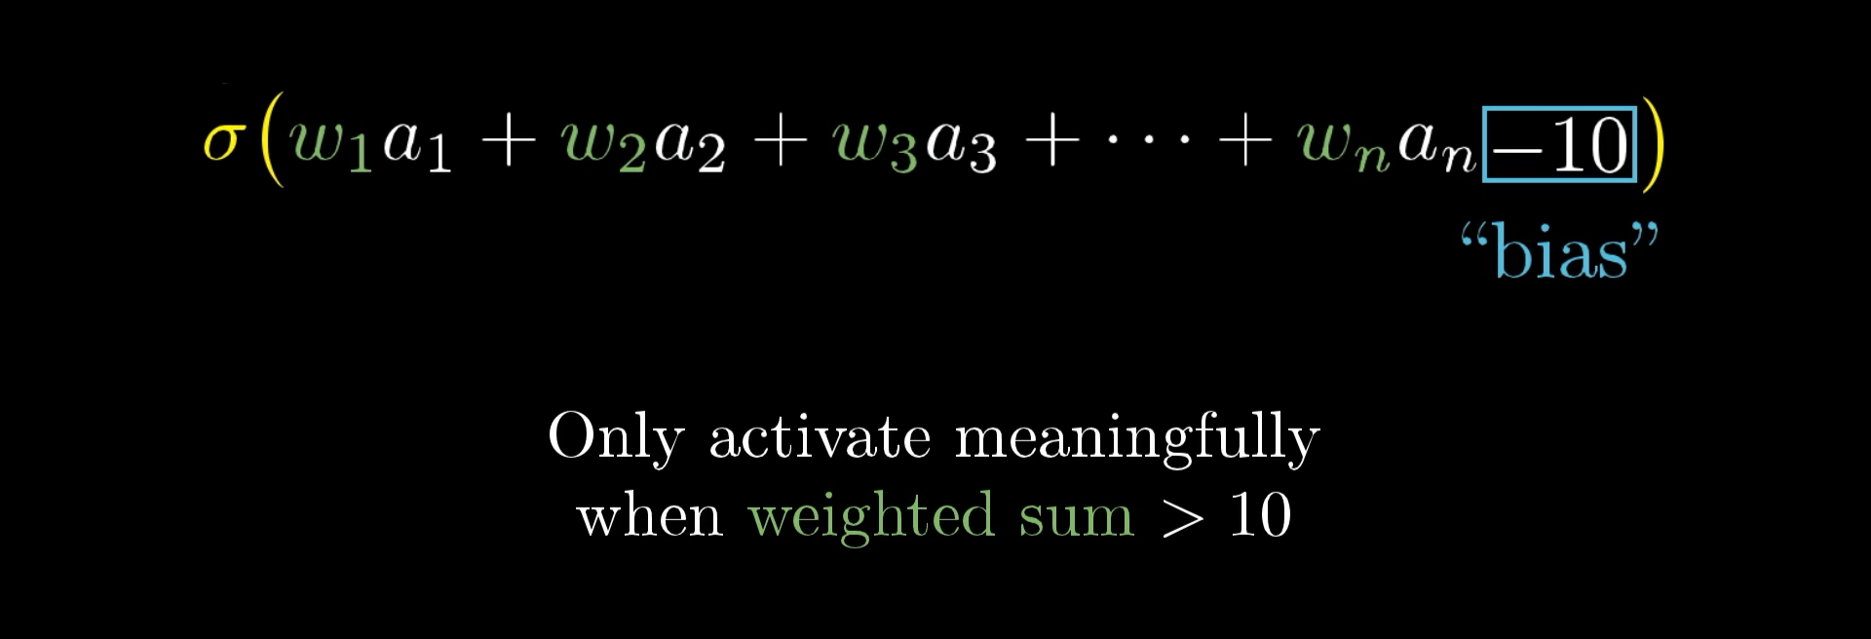
Maybe we only want it to be meaningfully active when that sum is bigger than, say, 10.

Slide 22
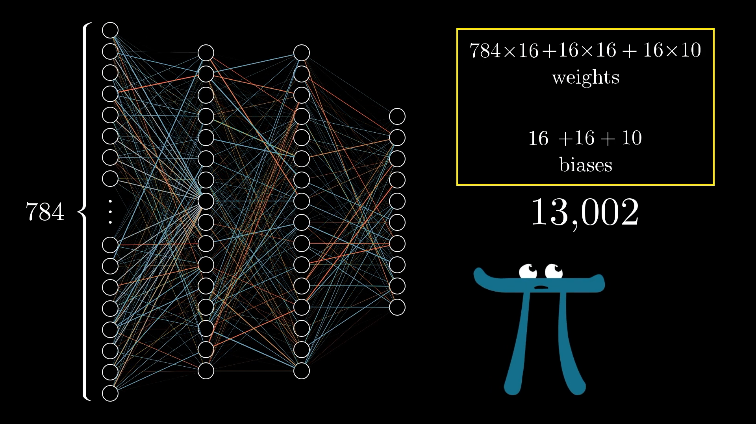

Slide 23
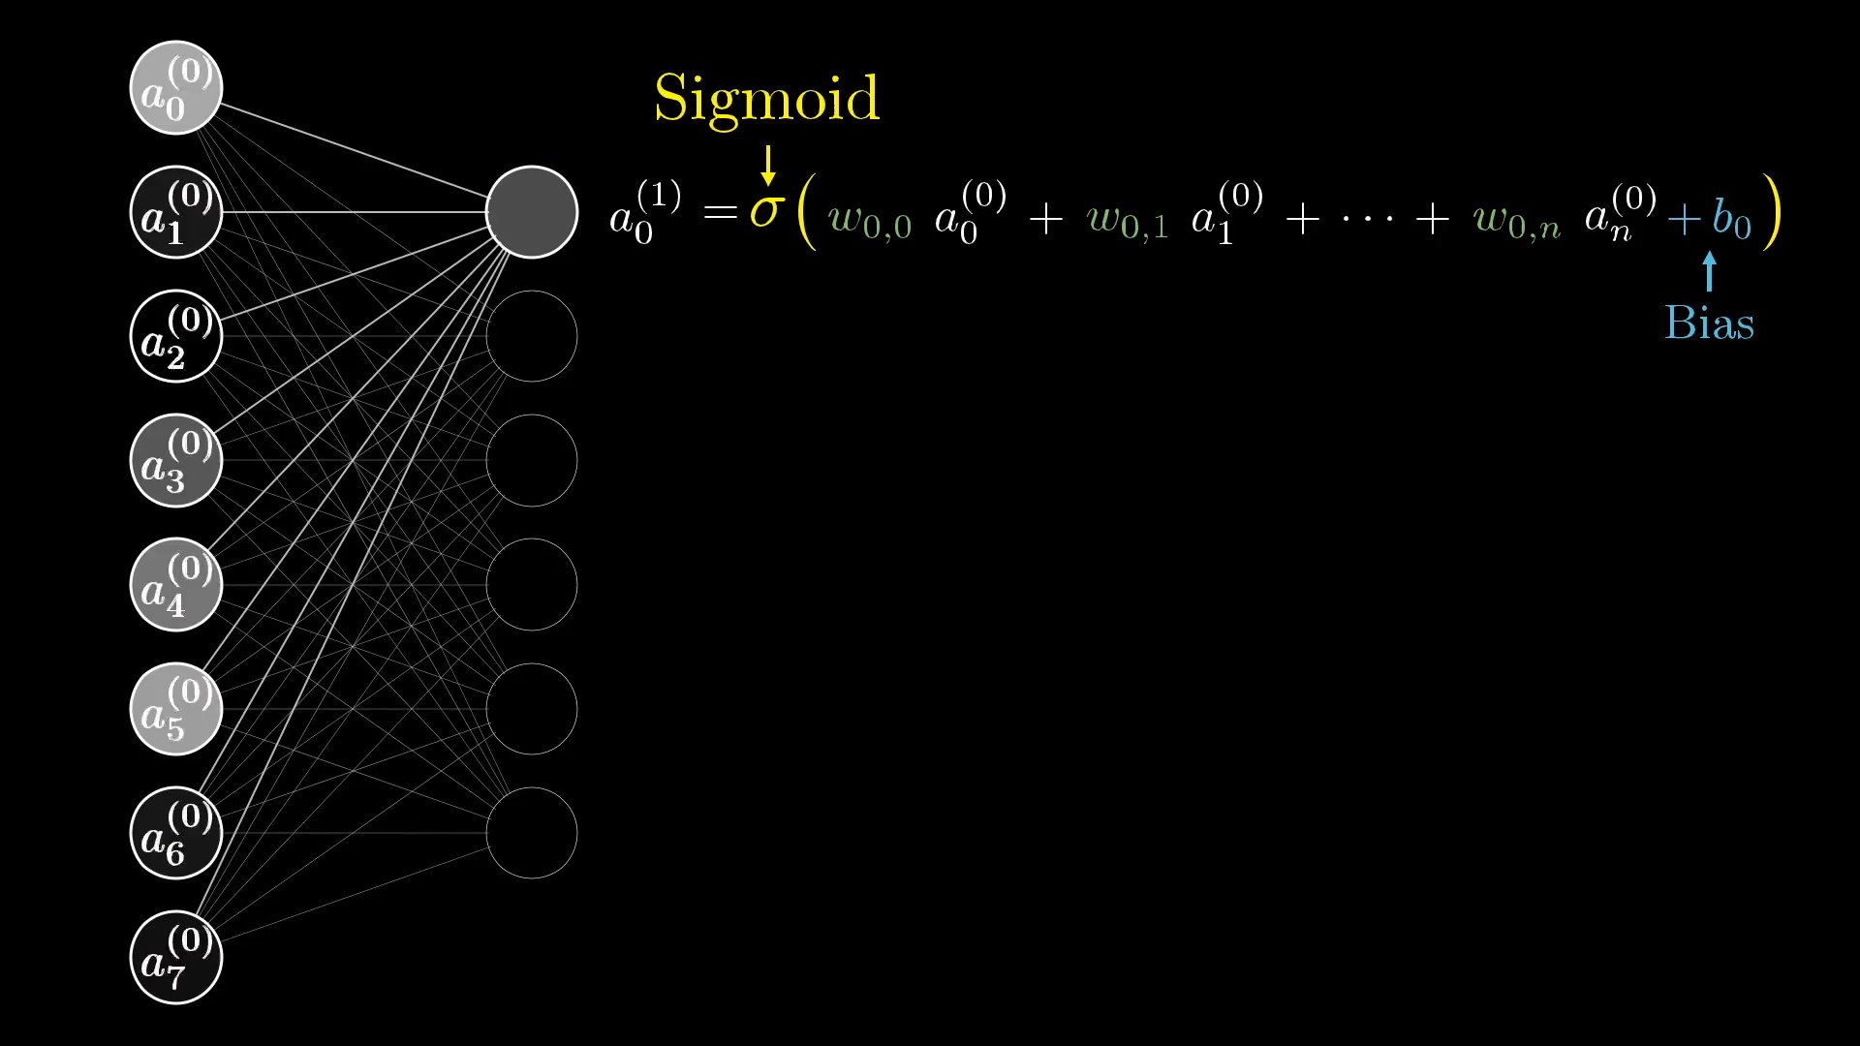

Slide 24
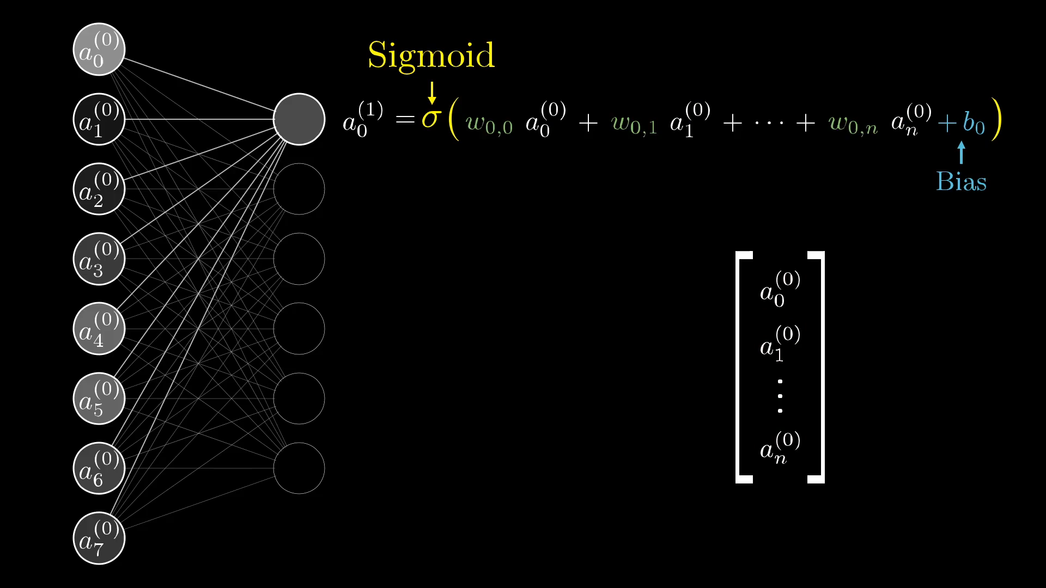

Slide 25
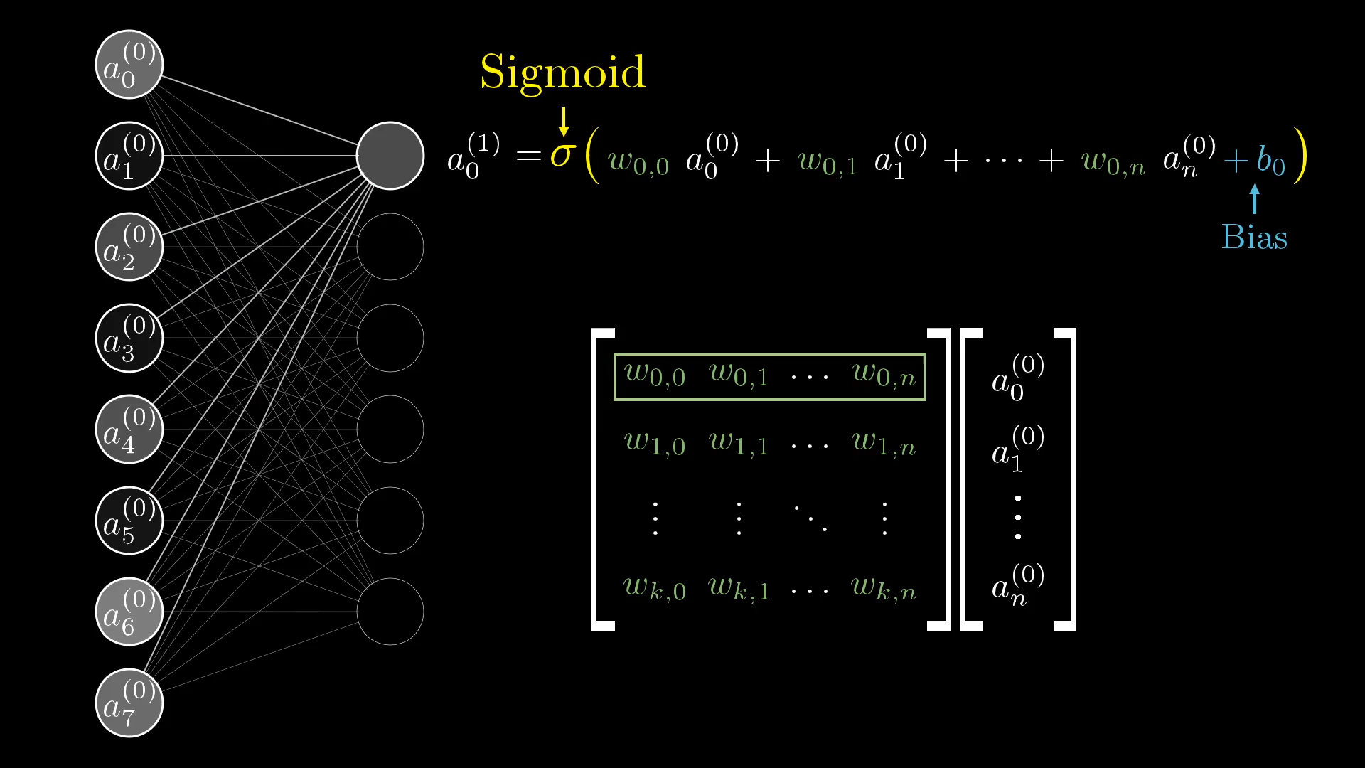

Slide 26
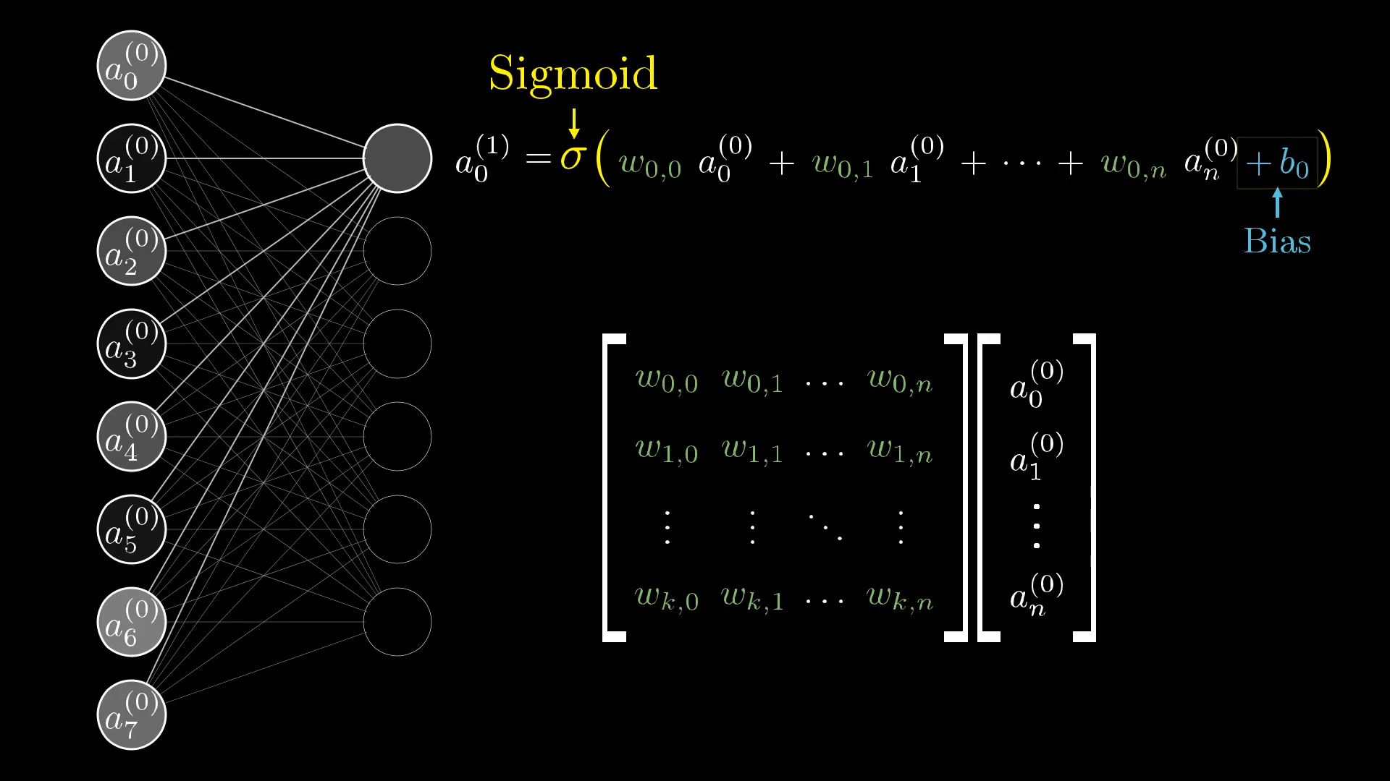

Slide 27
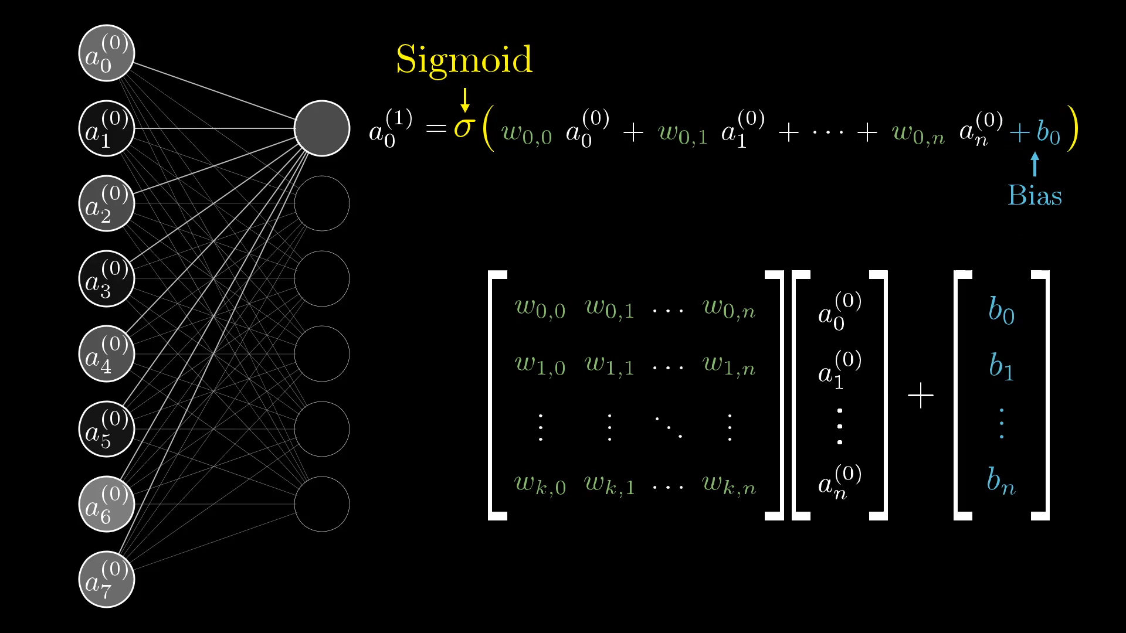

Slide 28
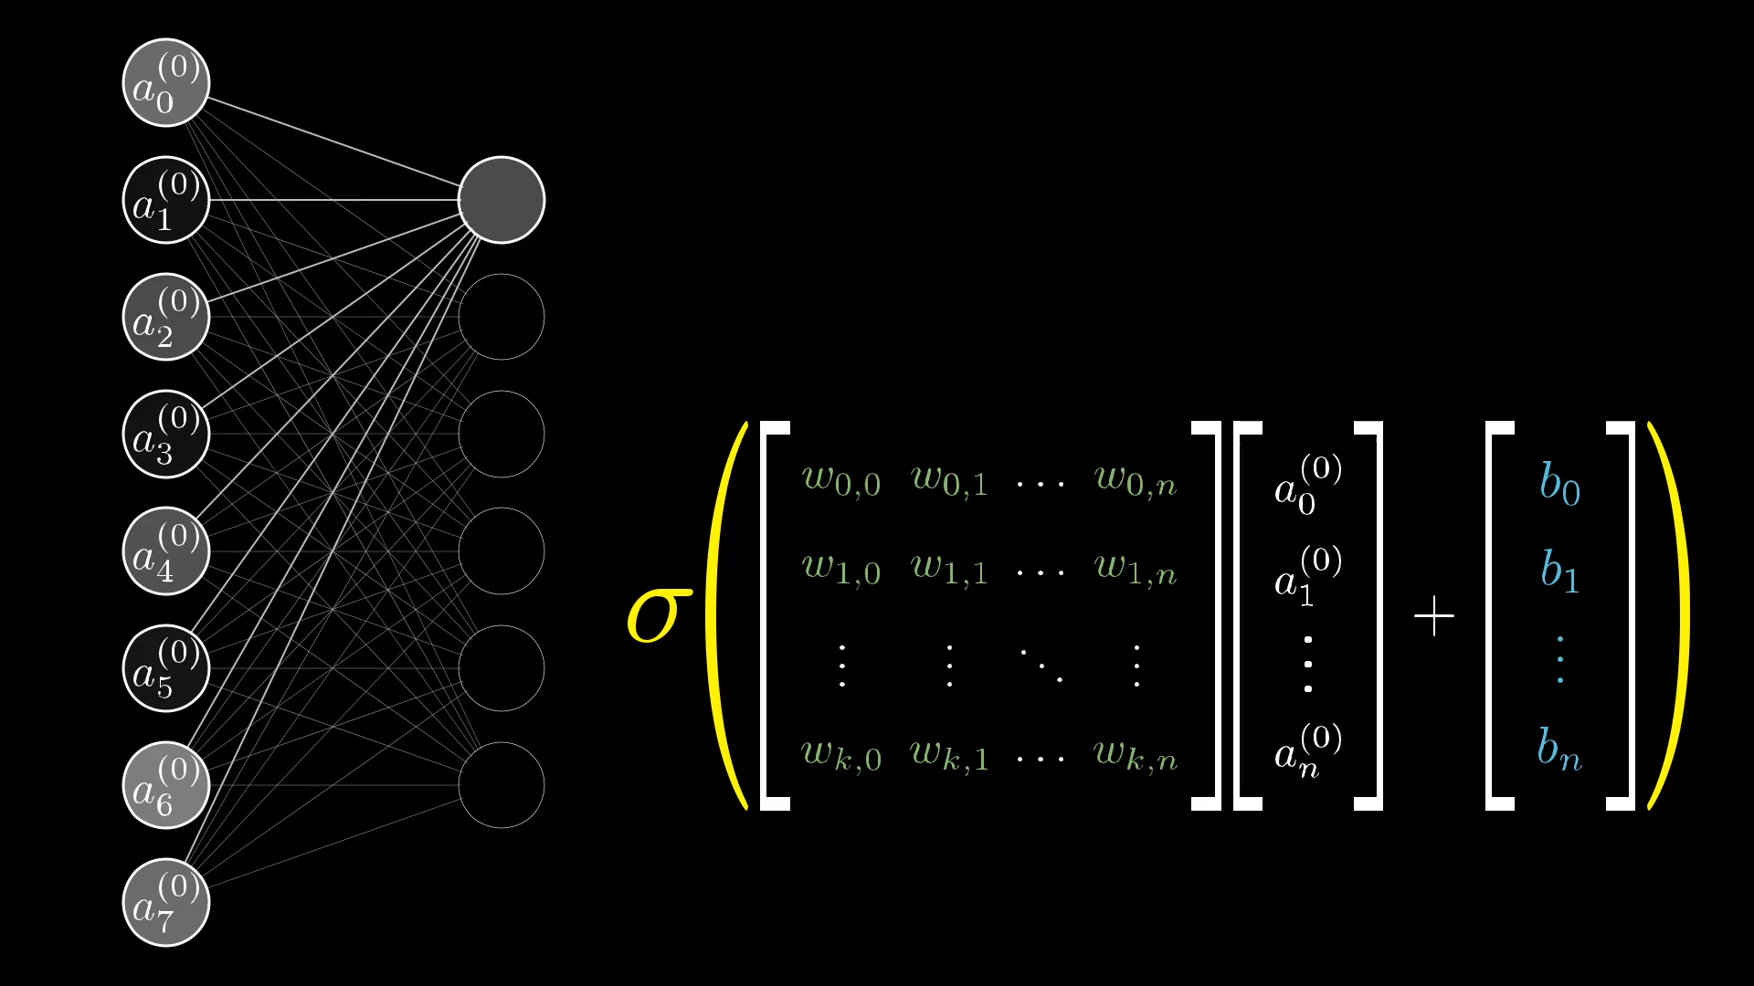

Slide 29
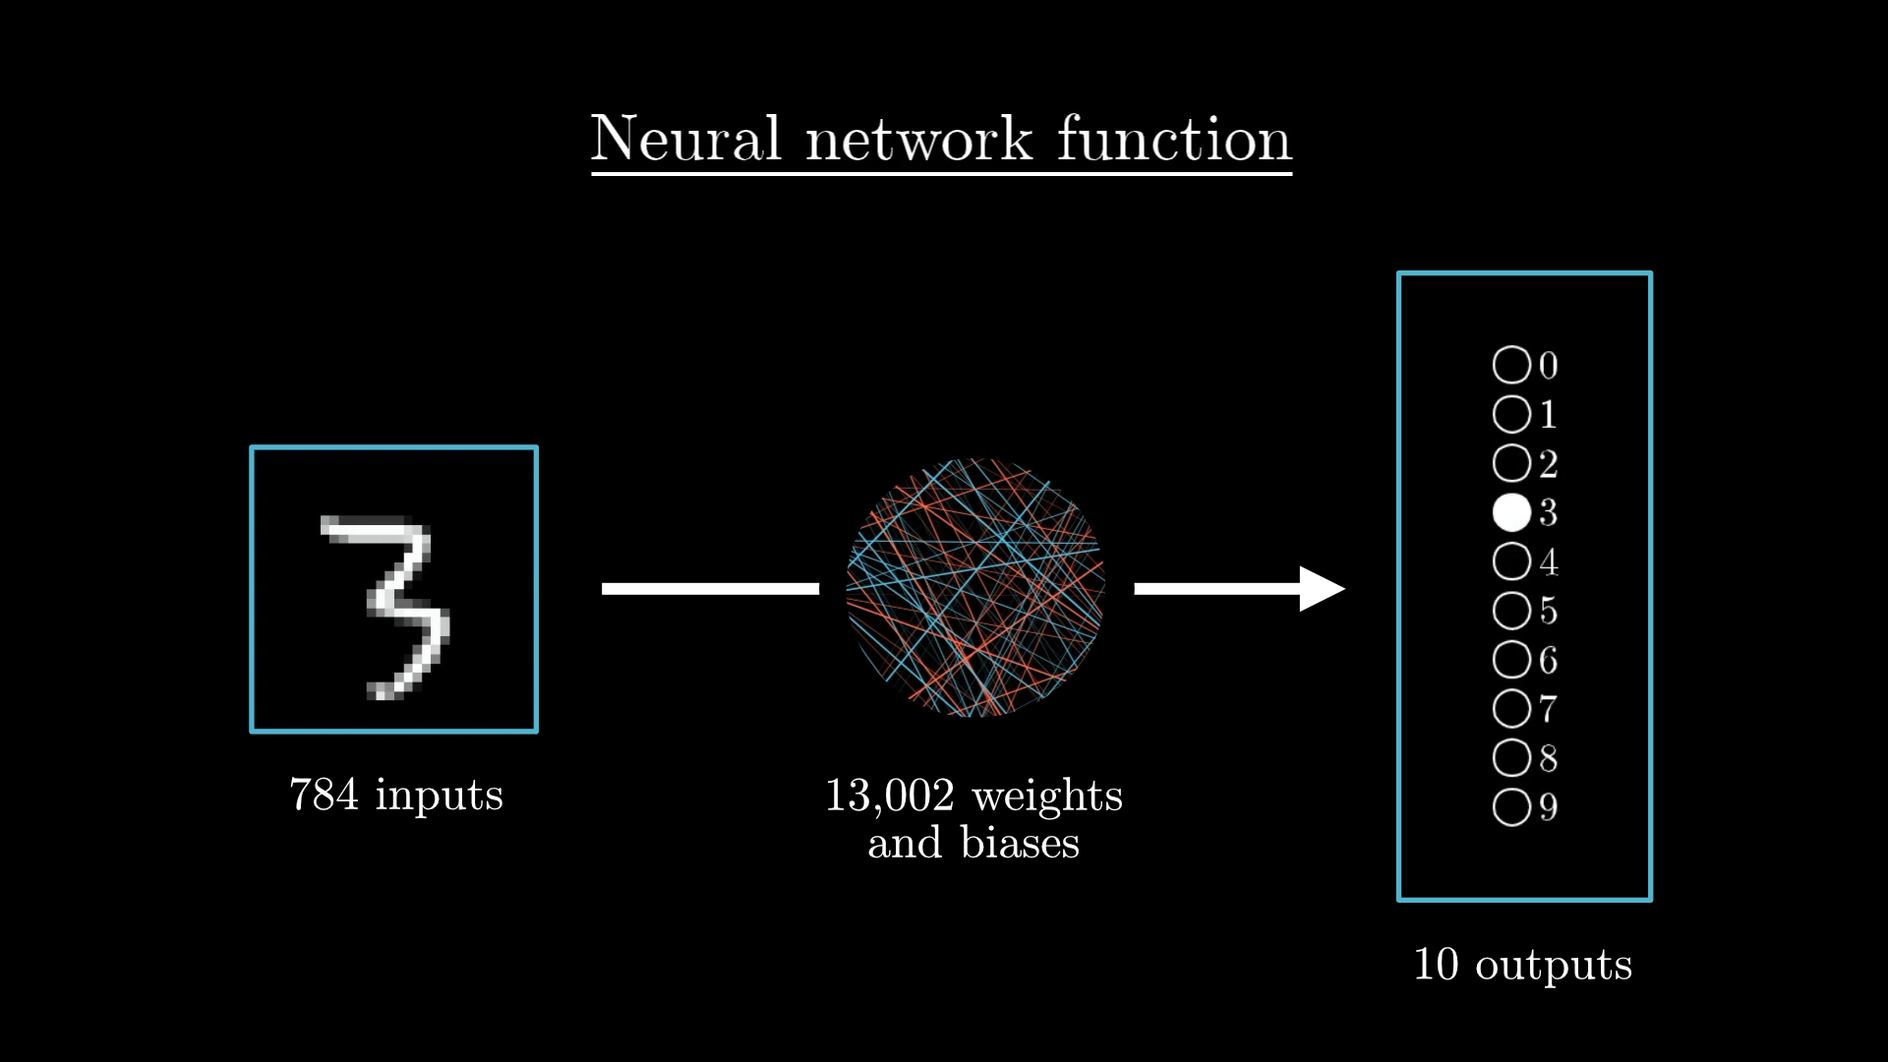
the entire network is just a function! It takes in 784 numbers as its input, and spits out 10 numbers as its output. It’s an absurdly complicated function, because it takes over 13,000 parameters (weights and biases), and it involves iterating many matrix-vector products and sigmoid squishificaitons together. But it’s just a function nonetheless.

Slide 30
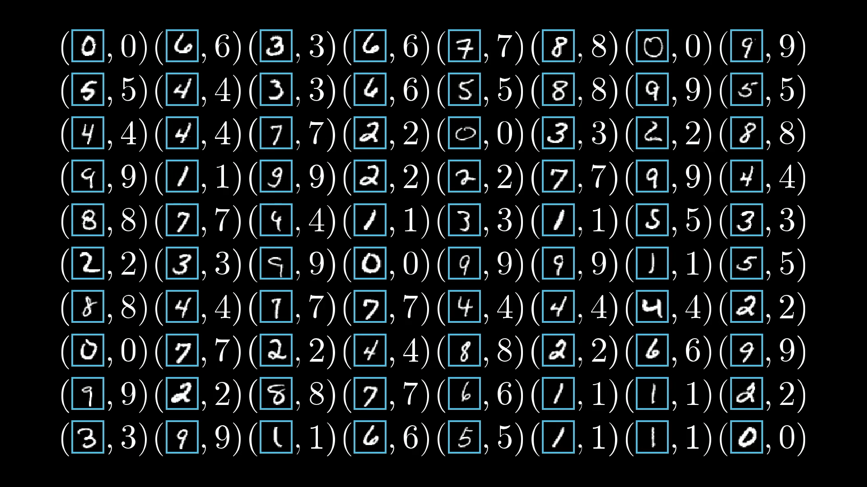
The network learns by looking at examples of correctly identified digits.

Slide 31
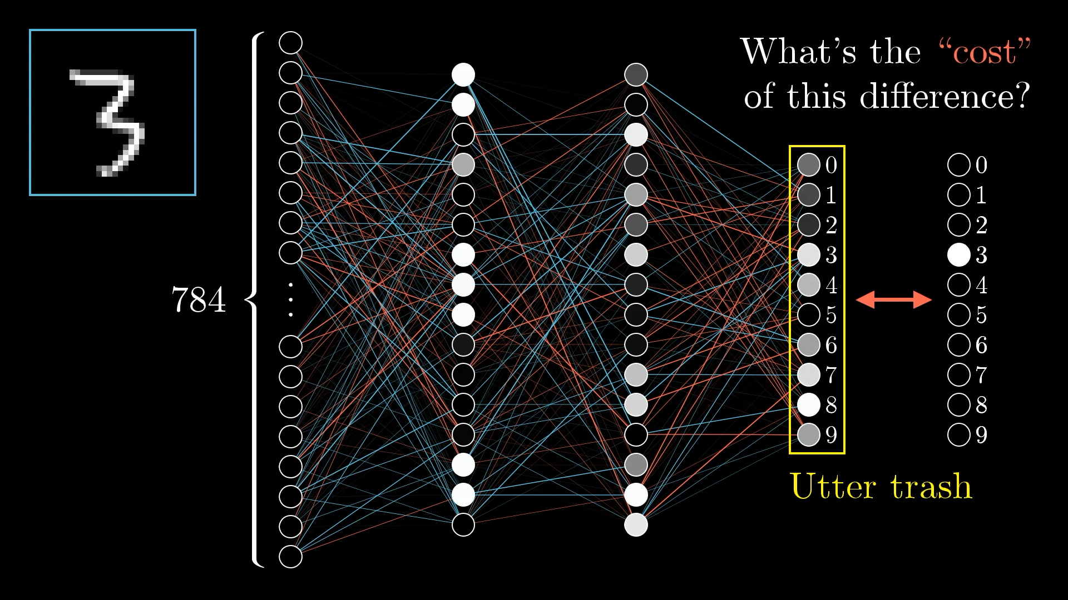
Initialized with totally random weights and biases, the network is terrible at identifying digits.

Slide 32
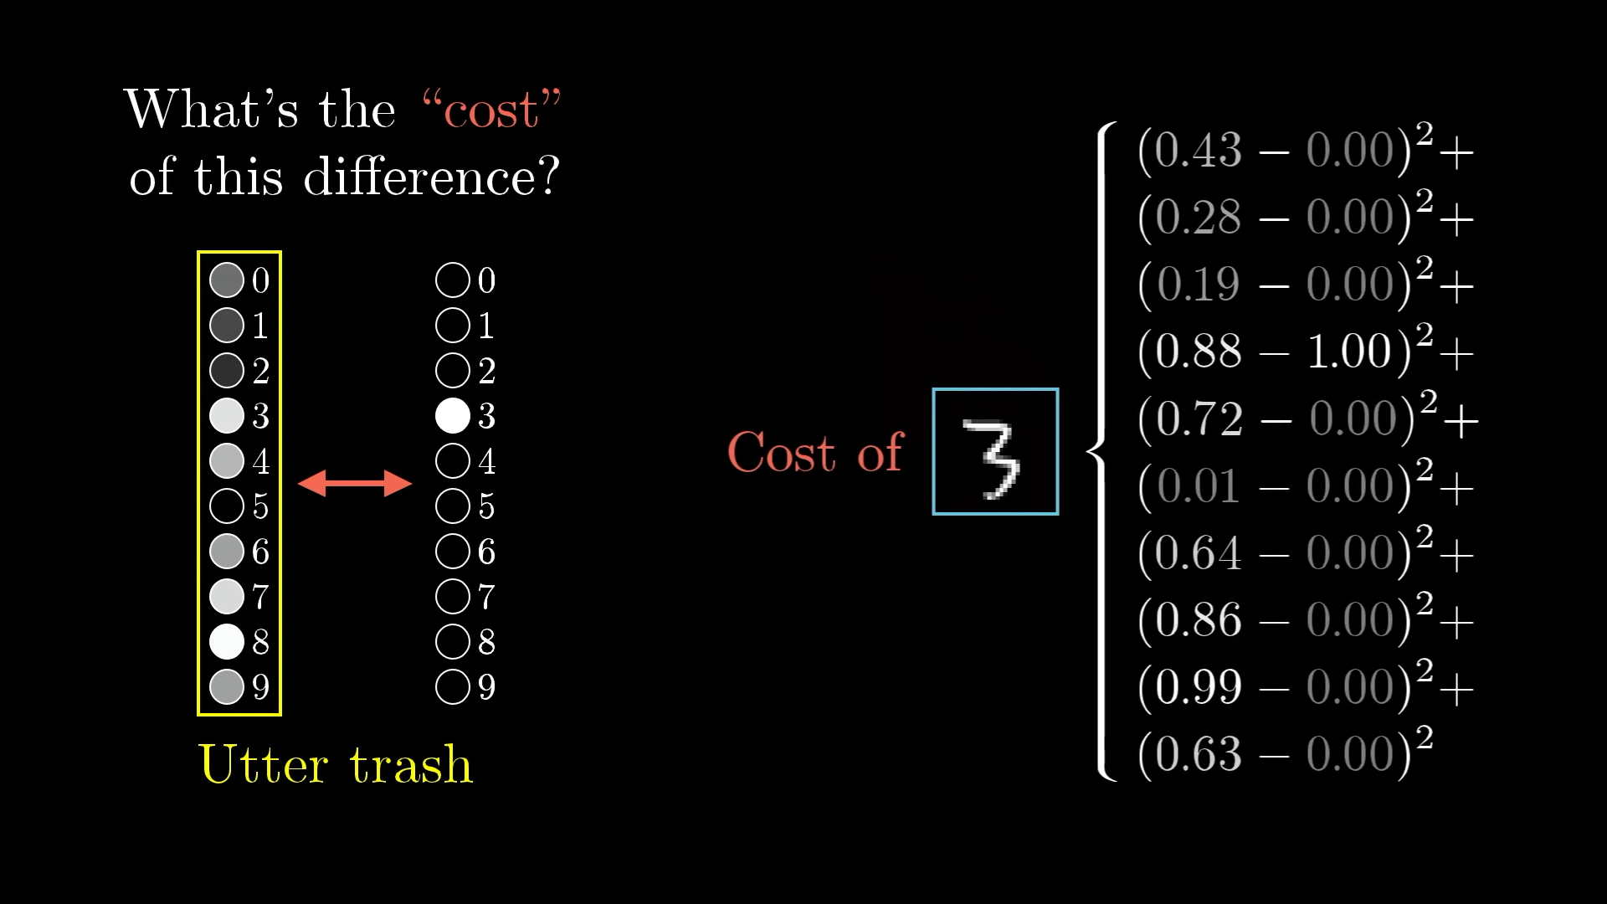
The "cost" is calculated by adding up the squares of the differences between what we got and what we want.

Slide 33
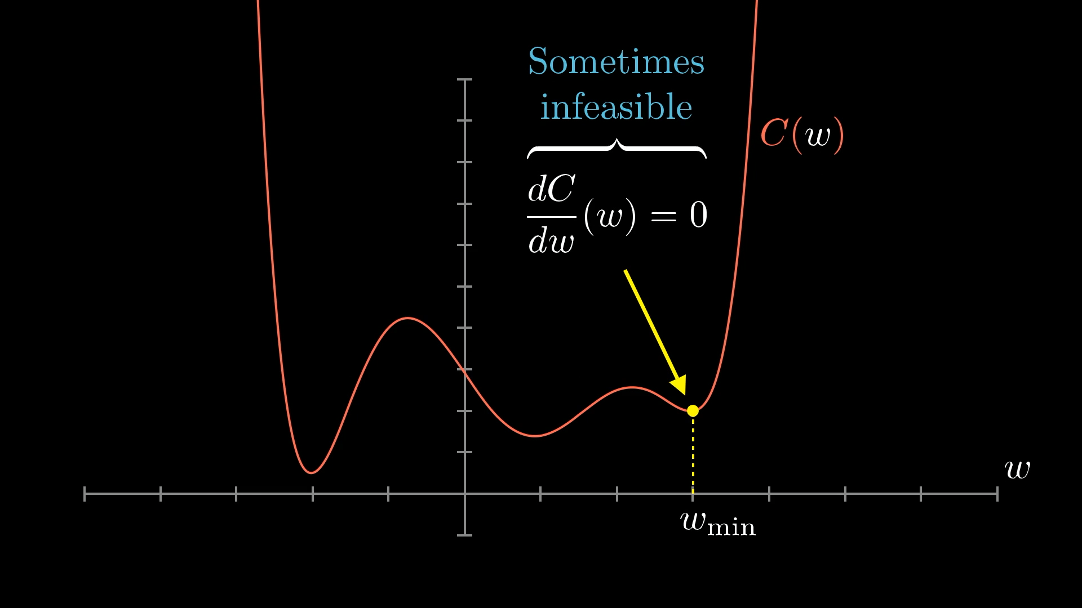

Slide 34
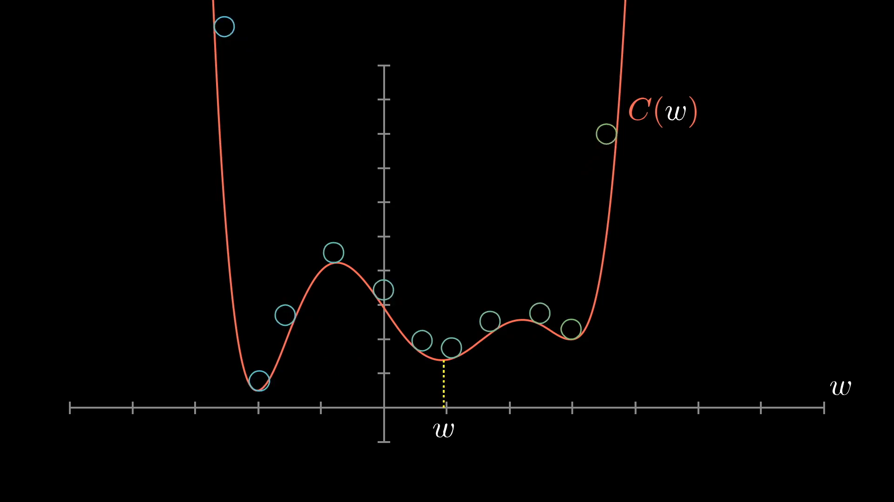

Slide 35
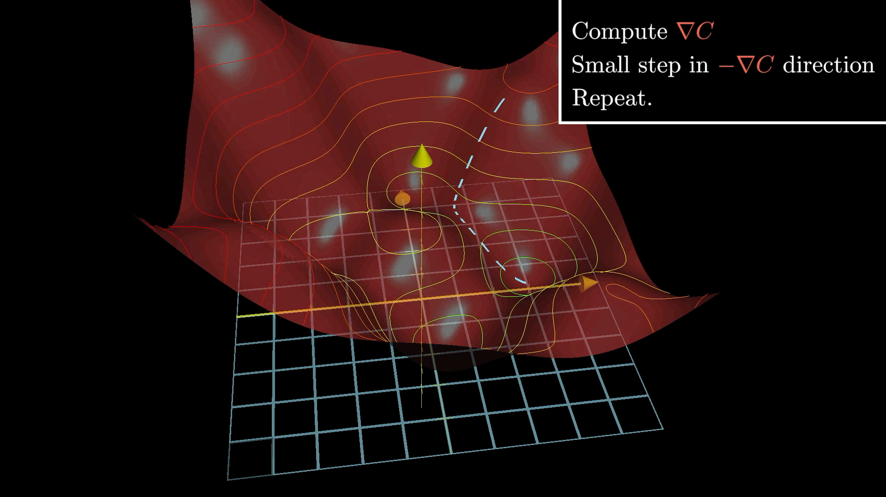
Gradient descent:
The gradient tells you which direction you should step to increase the function most quickly.

Slide 36
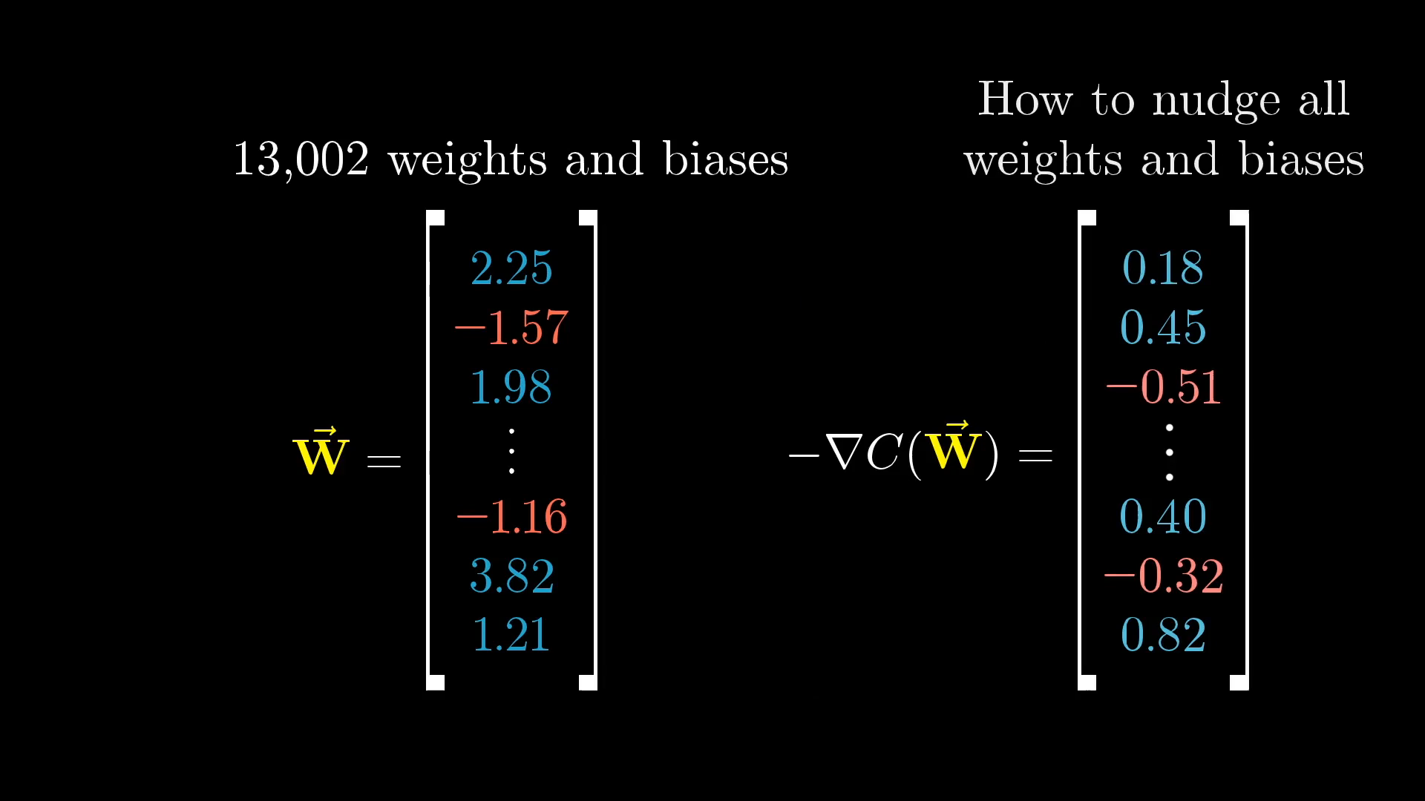
Each step: −η∇C; η=learning rate;
Take shorter steps closer to the minima

Slide 37
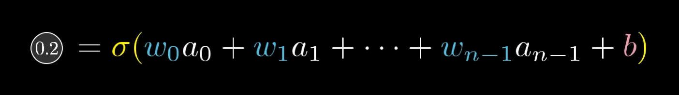
There are three avenues that can team up together to increase this activation:
Increase the bias
Increase the weights
Change the activations from the previous layer

Slide 38
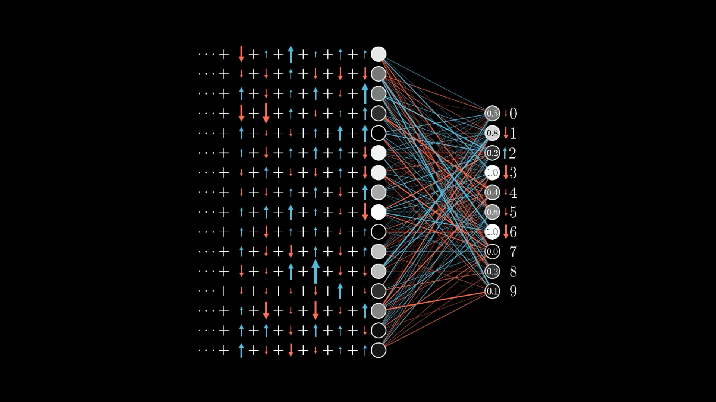
It’s impossible to perfectly satisfy all these competing desires for activations in the second layer.
The best we can do is add up all the desired nudges to find the overall desired change.

Slide 39
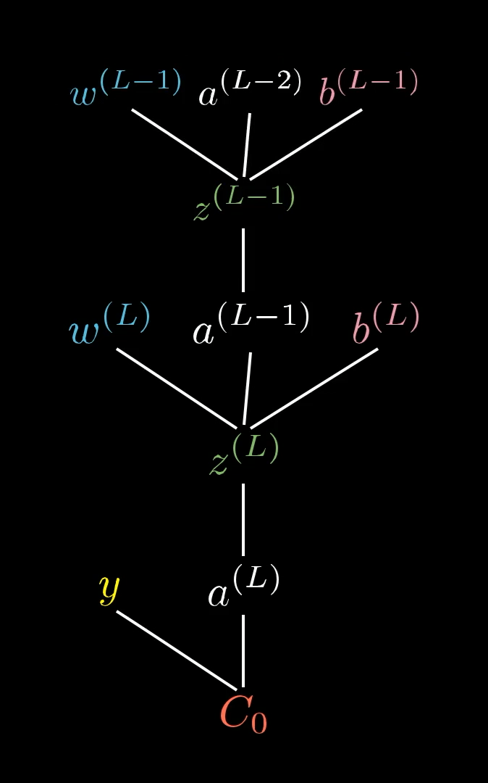
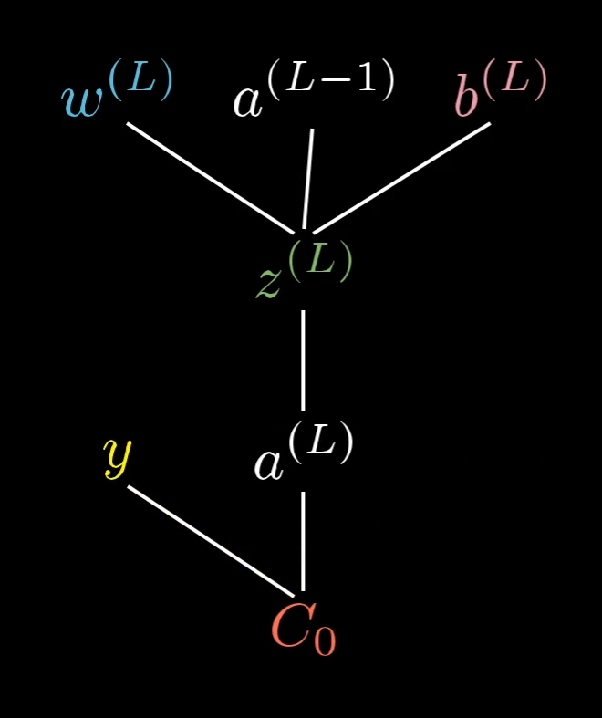
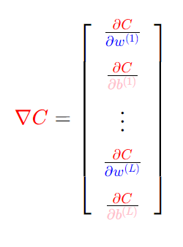
Calculating the Gradient with Backpropagation:

Slide 40
